Slide 2
Artificial Intelligence in Aviation 10 November 2023 - Rome
Automation and data protection – do we really have anything to fear from AI?
Andrea Poti
IFATCA Representative

Slide 3
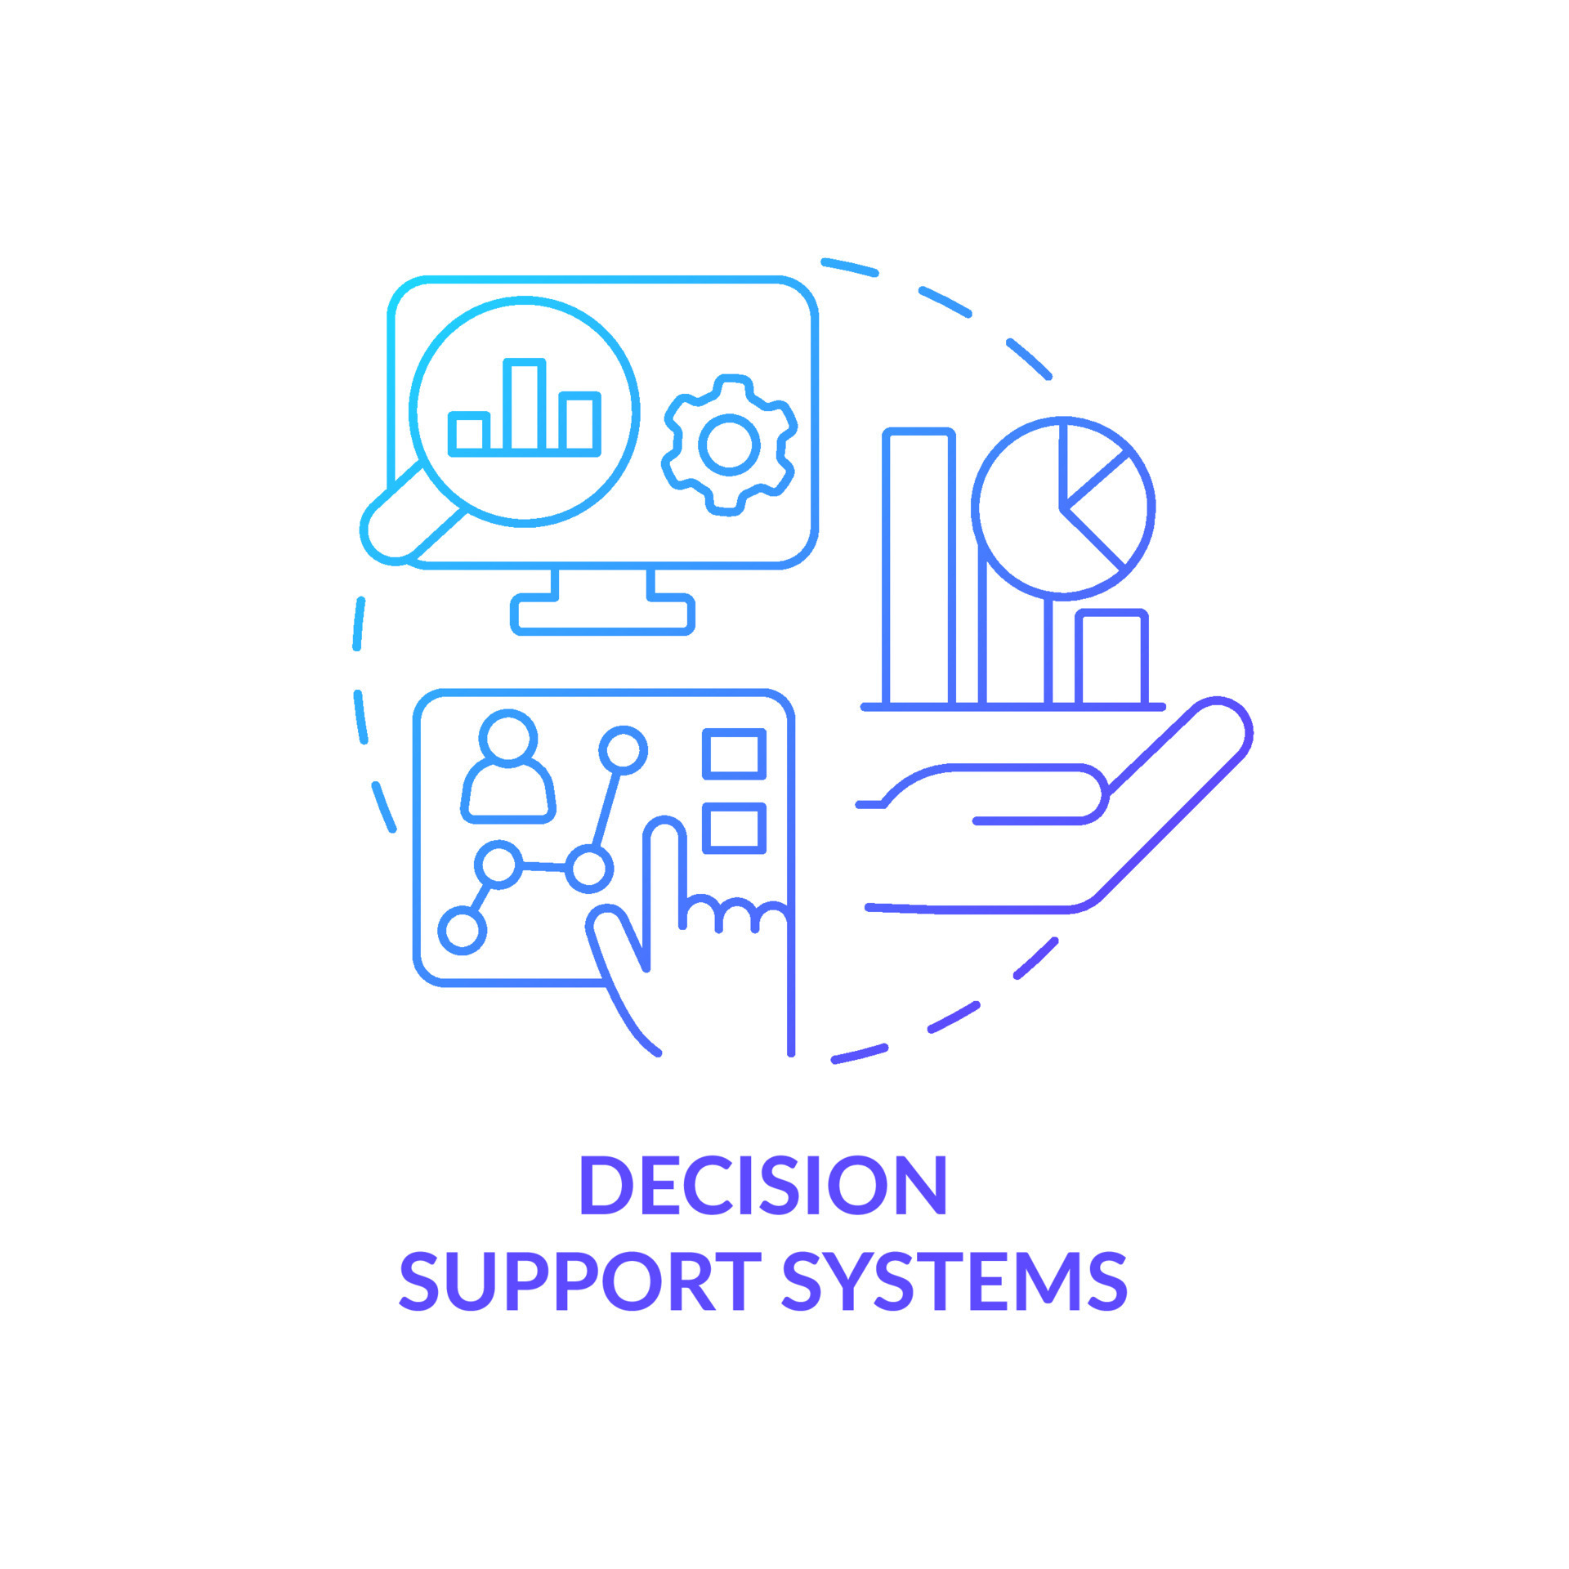
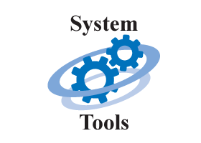
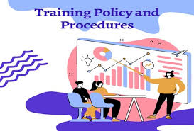
IFATCA Policy on AI:
1) Artificial Intelligence and/or Machine Learning
Source: intenet
2) Failure or not available, ATCO have the capacity to safely manage the AOR
3) AI systems shall be tested and validated
Source: intenet
4) shall be put in place to assist ATCOs,
in case of disruption
Source: intenet
Source: intenet

Slide 4
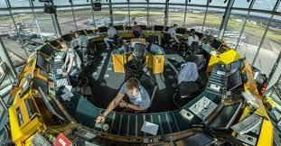
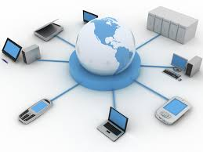
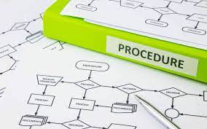
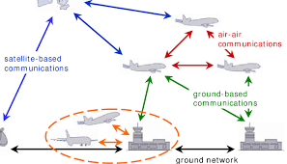
IFATCA Policy on CYBERSECURITY
1) Entitled to maximum security
2) Cyberattack that interferes with any system
Source: intenet
3) Services may be withdrawn during unlawful interference against ATC facilities --> contingency procedures
Source: intenet
Source: intenet
4) Communications includes all items related to tech/ops aspects of ATM voice and data communications systems, (facilities, procedures and applications that support them.
Source: intenet

Slide 5
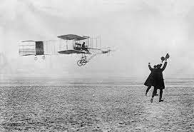
COMMUNICATIONS
Source: intenet
Operational Datalink
Data Communications Infrastructure
Voice Communications
Datalink applications, procedures;
Required Communication Performance (RCP) specifications
Emerging technologies and application to ATM; communication facilities to ensure their adequacy
Efficient ATM communication; changes in the institutional and operational environment (ICAO, 2020).

Slide 6
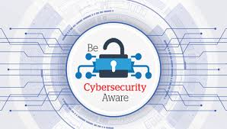
According to the Communications Panel (CP), the following areas of expertise are an integral part of Communications (ICAO, 2020):
The development and update of strategies and plans for aeronautical communications harmonization;
(…)
4) Development, adoption and implementation of procedures and guidance material for:
Air-ground and ground-ground data applications for air traffic services;
(…)
f) Items related to cybersecurity for ATM communications;
Source: intenet
Source: intenet

Slide 7
The purposes of cybersecurity are not different to the ones of plain security. In both cases the threats vary from the unauthorized access to sensitive information to an attacker taking control of a critical system or denying access to legitimate users, but cyber-threats have some peculiarities to be considered (Bruce Schneier. Secrets & Lies, Digital Security in a Networked World. Wiley Publishing. 2000).

Slide 8
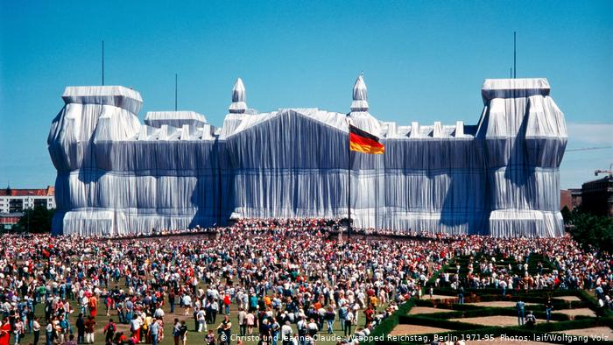
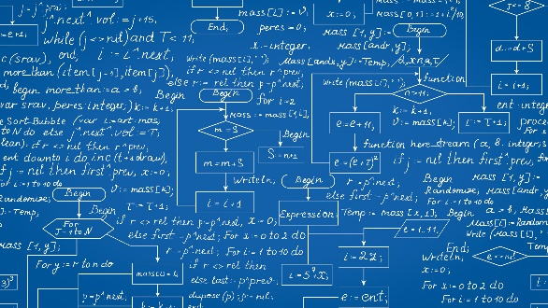
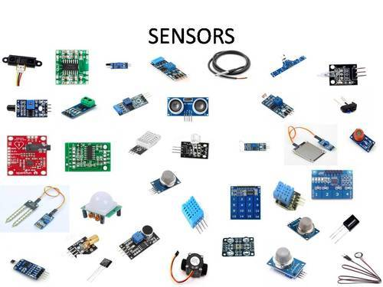
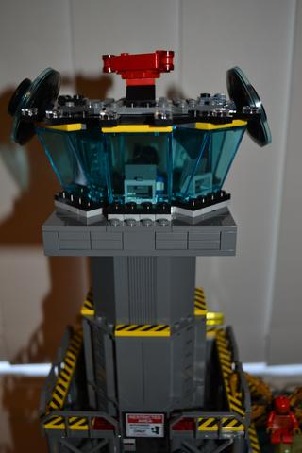
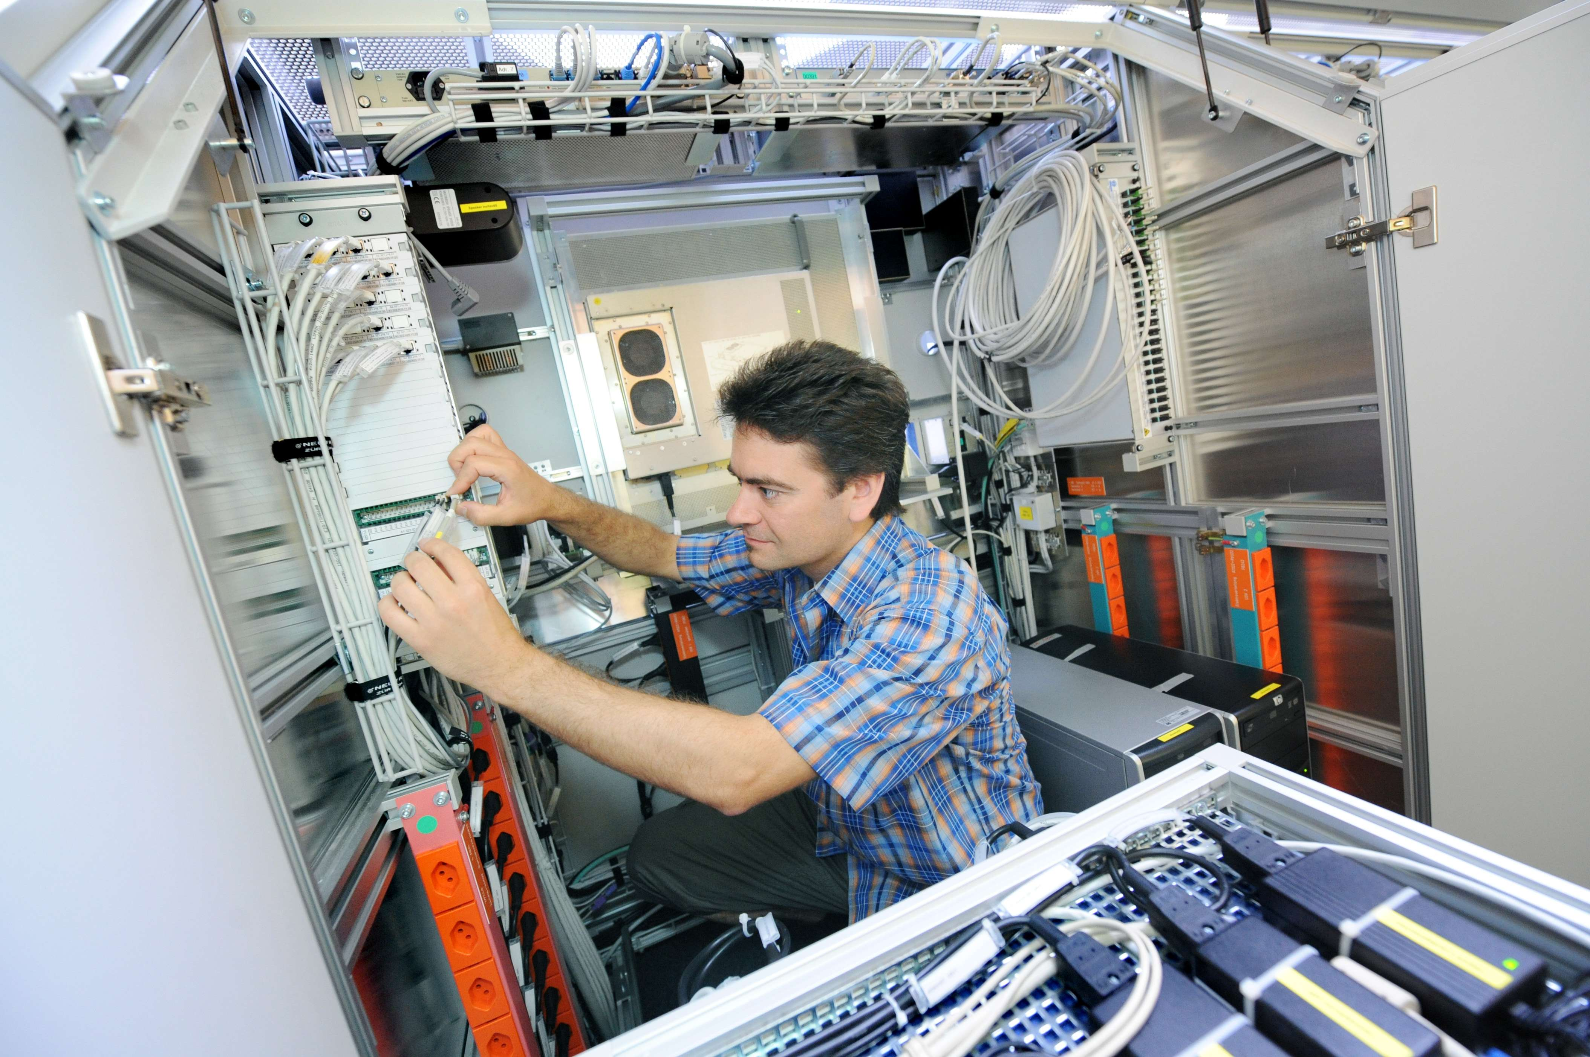
Digitalization of infrastructure – a few basics
Prof. Montero in Network Industries/quarterly 12/2020 No 22
https://cadmus.eui.eu/bitstream/handle/1814/69295/NIQ%20Vol%2022%20-%20Issue%204%20-%20December%202020%20final.pdf?sequence=1
Source: dw.com
Data layer being laid over the top of reality
Source: IT magazine
Algorithm
Artificial
Intelligence
Source: IT magazine
Source: intenet
Availability
Underlying
Infrastructure
Mirror image of reality
Source: satta.ch
Source: intenet

Slide 9
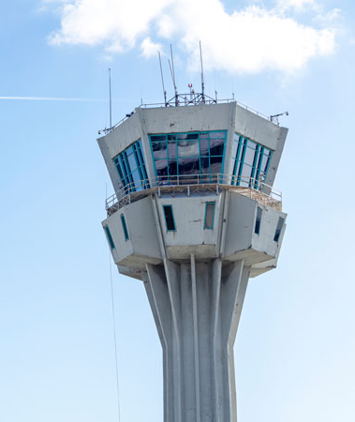
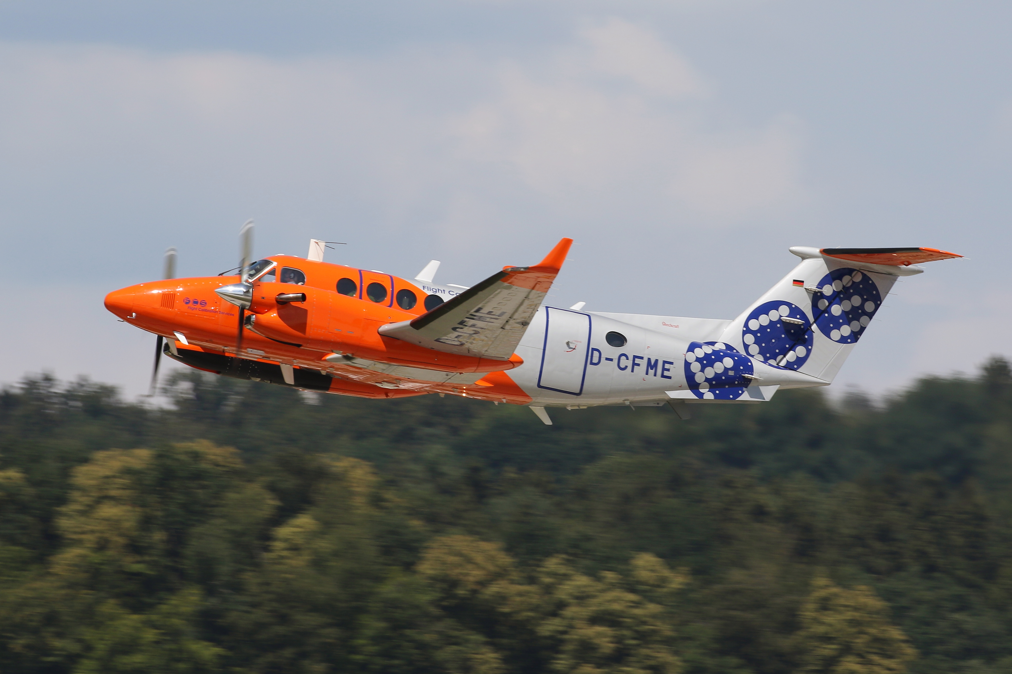
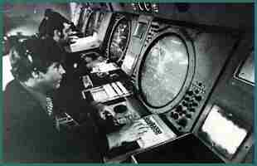
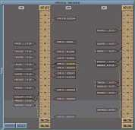
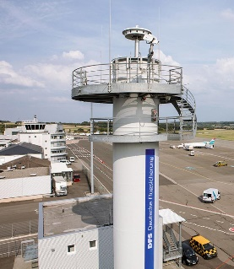
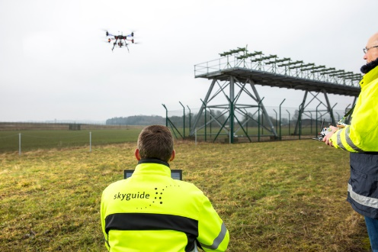
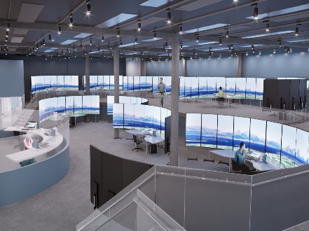
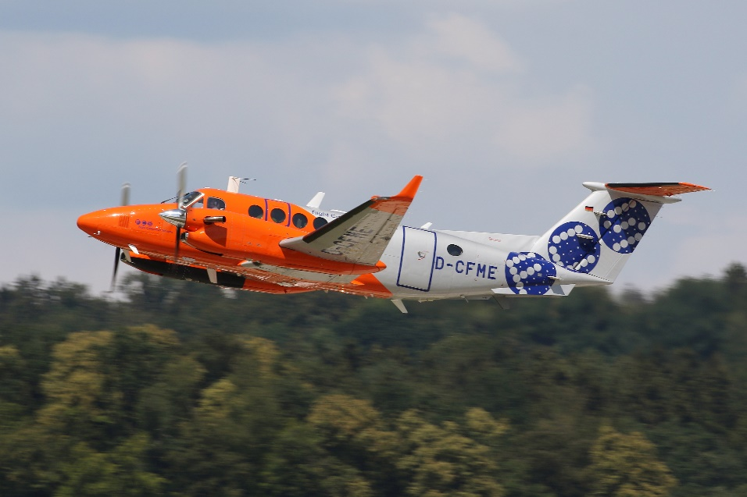
Digitalization of infrastructure – a few basics – cost reduction – applied to ATM
Prof. Montero in Network Industries/quarterly
12/2020 No 22
Cost reduction in
infrastructure
maintenance
Cost reduction
in the design &
construction of
infrastructure
Cost reduction in
charging for
infrastructure use
Cost reduction in
infrastructure
operations
Source:internationairportreview
Source: skynews.ch
Source: enav
Source: imansolas
Source:DFS
Source: Mozworks
Source: avinor
Source: Eurocontrol phare

Slide 10
Automation
Novel failure scenario
A common standard
Emerging properties
Less fragmentation
Unexplainable situation
House keeping task
Independent
Unethical
Fear
No fear
Misuse of Safety data
Increased transparency
Violation of personal data
Cyber attacks
Secure Com
Corrupted data
Use of Blockchain
Novel failure scenario
Data protection

Slide 11
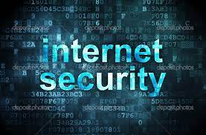
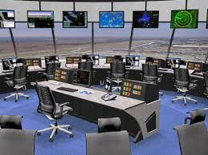
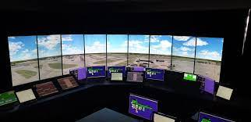
Training and Education
Intrusion in a system to steal data is one of the most common examples of the risks
training on how to detect email;
how to avoid clicking email
Ops Room/TWR:
what an attack/threat could be (position of a/c, routing);
operational briefing (to know/to be aware)
To be trained, how to react/what to do/manage flights safely:
in case of system failure;
something is strange (giving instructions turn/ident/extra separation)
Source: intenet
Source: intenet
Source: intenet

